Slide 1
Hysacs project
HYPERSPECTRAL IMAGE SEGMENTATION AND ANALYSIS TOWARDS AUTOMATED NON-DESTRUCTIVE MEASUREMENTS OF OLIGOSACCHARIDES AND OTHER TRAITS
Wednesday, June 3, 2020

Slide 2
Contents
Segmentation
Dataset
Results

Slide 3
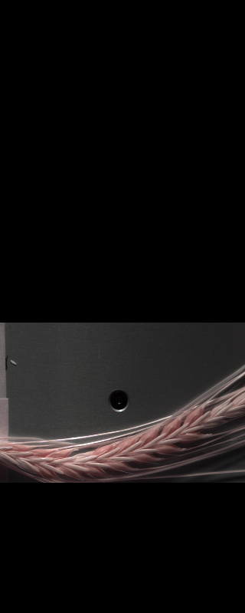
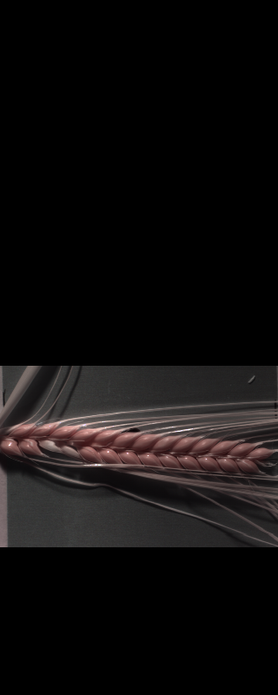
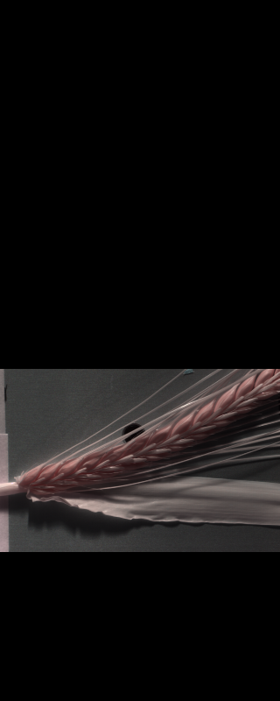
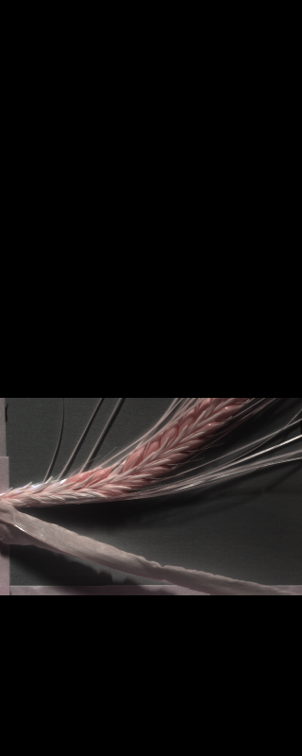
Segmentation
97% of images are properly segmented
Five Images were damaged
14 images improperly segmented

Slide 4
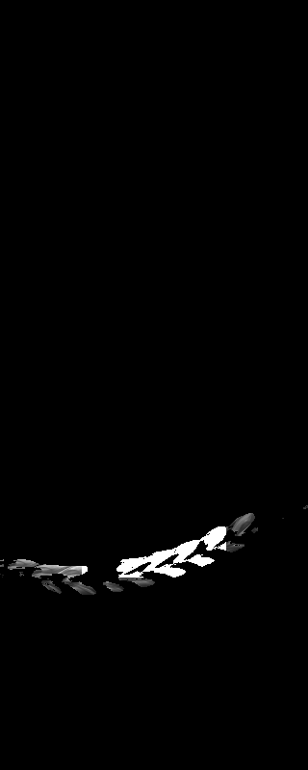
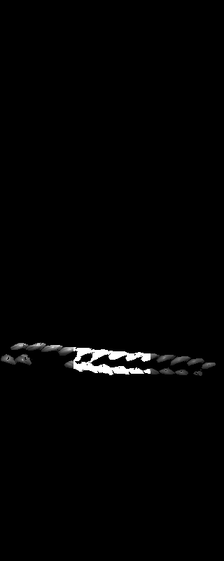
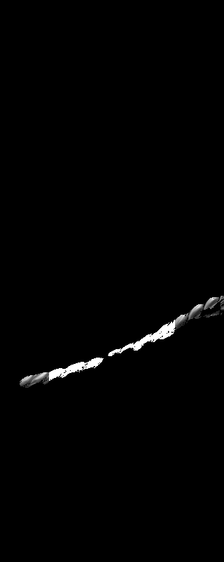
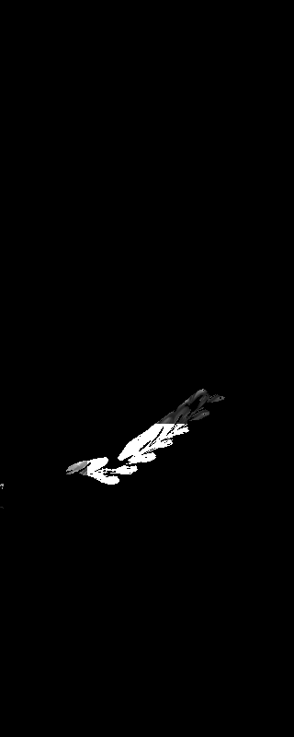
Segmentation
97% of images are properly segmented
Five Images were damaged
14 images improperly segmented

Slide 5
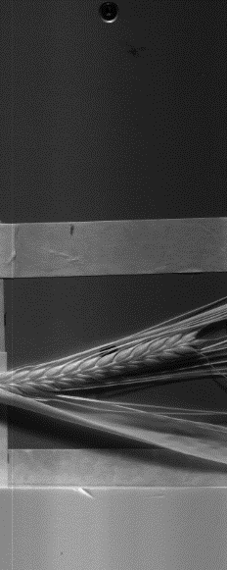

Daylight Intensity
Mean value of yellow highlighted area is taken as reference for daylight intensity value
1
256

Slide 6
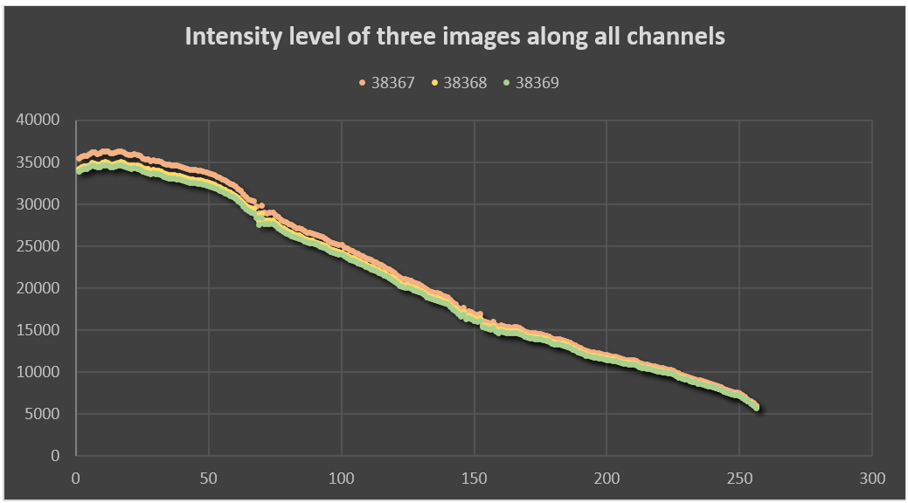
Daylight Intensity
Mean value of each channel is taken as reference for daylight intensity value

Slide 7
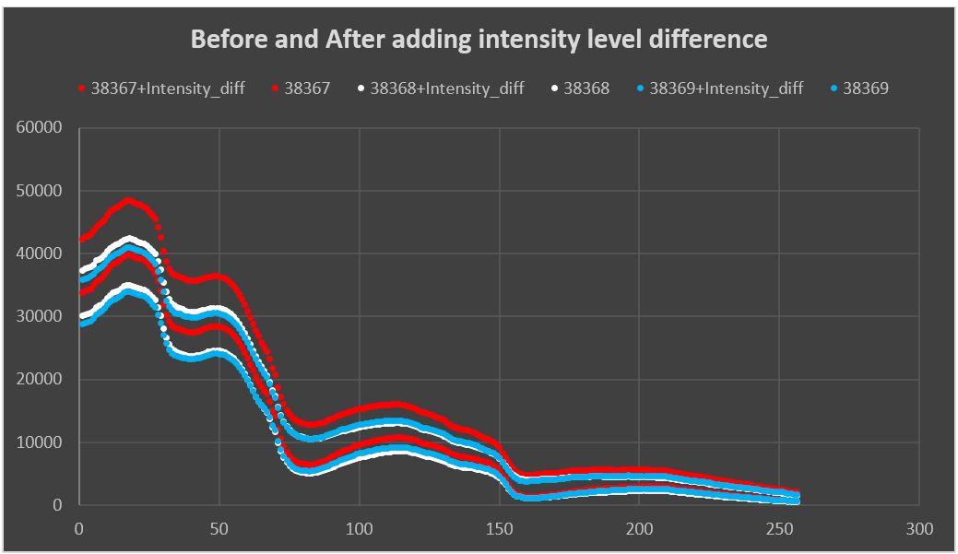
Daylight Intensity
Difference of intensity level of each image added on respective image though all channels

Slide 8
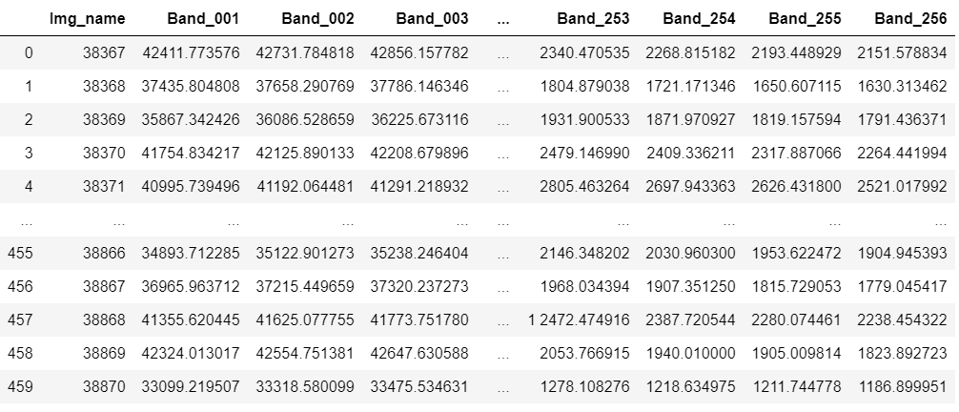
Dataset

Slide 9
Models
Split the dataset Based on Genotype

Slide 10
Ridge Regression
Sugar Contents | Mean absolute error | R^2 error | Mean square error
Glucose | 0.511074901 | -3.88061 | 0.442623544
Fructose | 0.626878935 | -3.58233 | 0.658037805
Sucrose | 4.516844231 | -4.40465 | 30.37255988
Raffinose | 2.893977891 | -5.39806 | 13.55439056
Kestose | 1.917278963 | -7.69109 | 5.886601115
Maltose | 0.578016671 | -8.63727 | 0.5331861
Nystose | 1.677731598 | -7.77544 | 4.987306438
Kestopentaose | 0.532623374 | -8.84136 | 0.455078583
Total_Fructan | 8.090380188 | -6.3398 | 111.5696898

Slide 11
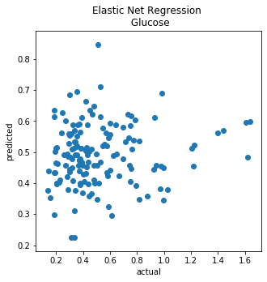
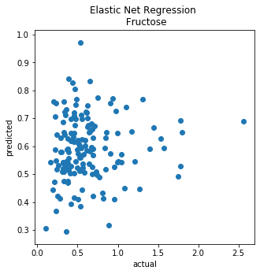
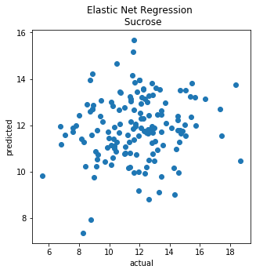
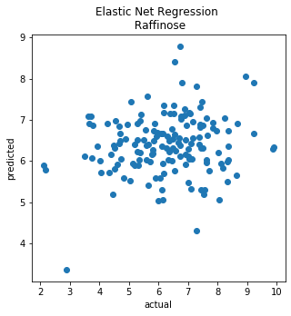
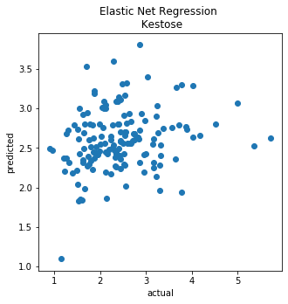
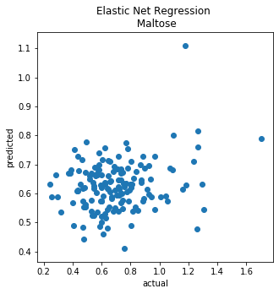
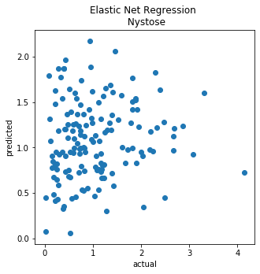
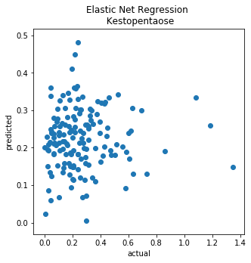
Ridge Regression

Slide 12
Elastic Net
Sugar Contents | Mean absolute error | R^2 error | Mean square error
Glucose | 0.225395 | -0.03672 | 0.09402
Fructose | 0.272316 | -0.04594 | 0.150201
Sucrose | 2.072446 | -0.17048 | 6.577736
Raffinose | 1.223988 | -0.10549 | 2.342003
Kestose | 0.667266 | -0.06532 | 0.721554
Maltose | 0.179537 | -0.05939 | 0.058611
Nystose | 0.634522 | -0.17936 | 0.670258
Kestopentaose | 0.160034 | -0.14356 | 0.05288
Total_Fructan | 3.773329 | -0.58032 | 24.02191

Slide 13
Elastic Net

Slide 14
Lasso
Sugar Contents | Mean absolute error | R^2 error | Mean square error
Glucose | 0.22319 | -0.05337 | 0.09553
Fructose | 0.264749 | -0.05339 | 0.15127
Sucrose | 2.049952 | -0.15177 | 6.472586
Raffinose | 1.161771 | -0.00836 | 2.136232
Kestose | 0.662869 | -0.04797 | 0.709804
Maltose | 0.17603 | -0.04968 | 0.058074
Nystose | 0.612399 | -0.05749 | 0.600999
Kestopentaose | 0.158774 | -0.09359 | 0.050569
Total_Fructan | 3.405795 | -0.30661 | 19.86133

Slide 15
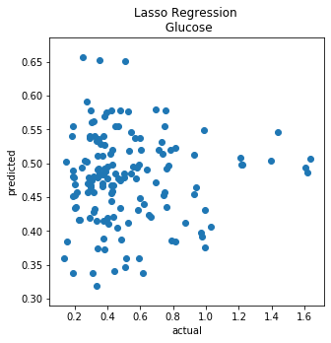
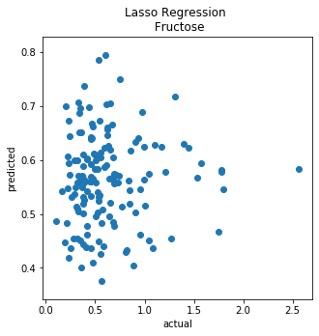
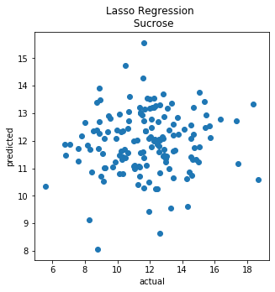
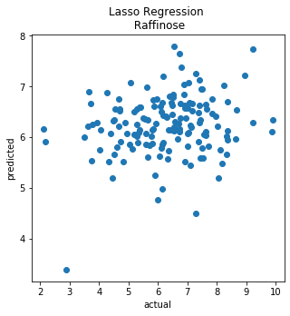
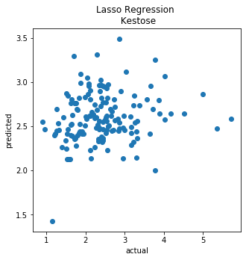
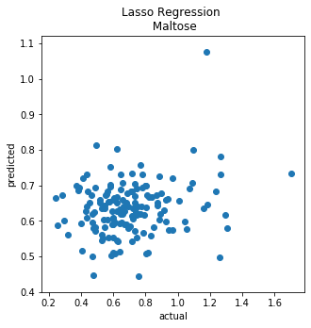
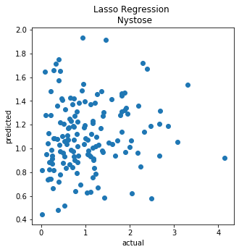
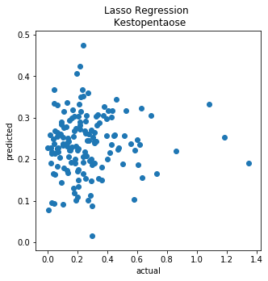
Lasso

Slide 16
R^2 error

Slide 17
Mean absolute error

Slide 18
Mean square error

Slide 19
Models
Based on Randomly splitting dataset in to train and test (taking means of 10 replicates)

Slide 20
Ridge Regression
Sugar Contents | Mean absolute error | R^2 error | Mean square error
Glucose | 0.441288 | -3.0415 | 0.324161
Fructose | 0.579718 | -3.48335 | 0.562616
Sucrose | 3.550131 | -2.64905 | 20.32791
Raffinose | 2.058246 | -2.58193 | 6.888539
Kestose | 1.366227 | -2.94252 | 2.942811
Maltose | 0.392421 | -2.48984 | 0.25688
Nystose | 1.366642 | -2.97526 | 2.933128
Kestopentaose | 0.391586 | -3.02246 | 0.249752
Total_Fructan | 6.465502 | -2.93823 | 67.35755

Slide 21
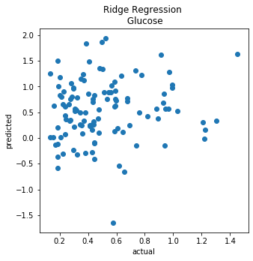
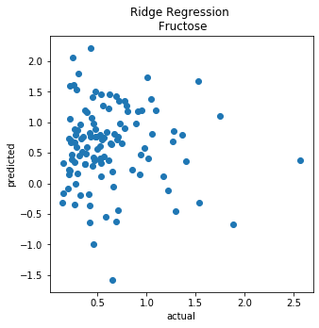
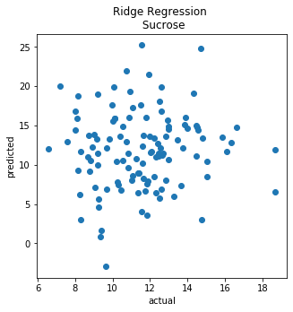
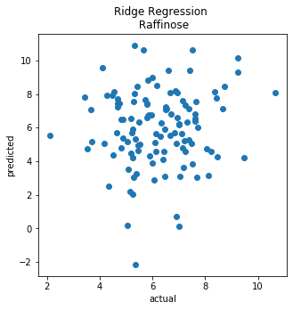
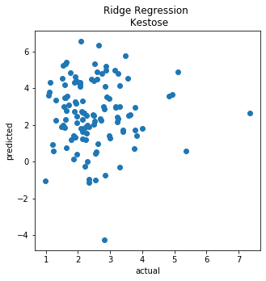
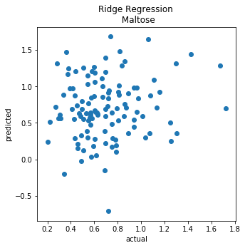
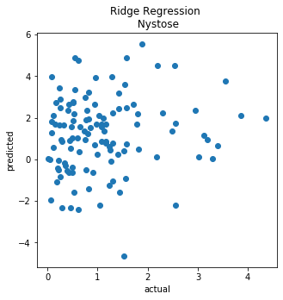
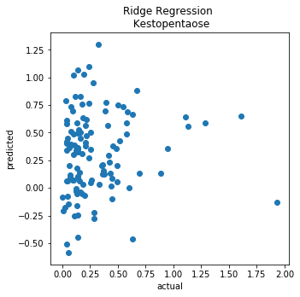
Ridge Regression

Slide 22
Elastic Net
Sugar Contents | Mean absolute error | R^2 error | Mean square error
Glucose | 0.221439 | 0.056633 | 0.083809
Fructose | 0.277698 | 0.04544 | 0.141775
Sucrose | 1.960413 | -0.08924 | 6.061645
Raffinose | 1.106896 | -0.01355 | 1.974434
Kestose | 0.668826 | 0.007923 | 0.783563
Maltose | 0.185754 | 0.132907 | 0.064505
Nystose | 0.706149 | 0.02043 | 0.789722
Kestopentaose | 0.196809 | 0.025075 | 0.073493
Total_Fructan | 3.525995 | -0.14442 | 21.76777

Slide 23
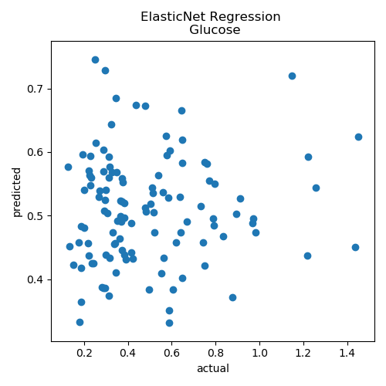
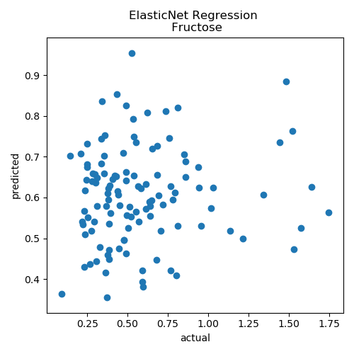
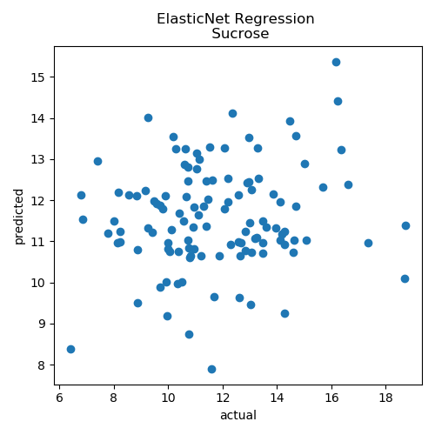
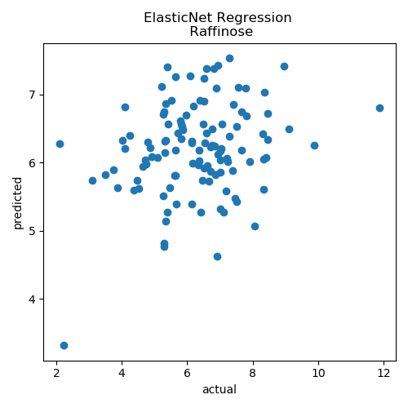
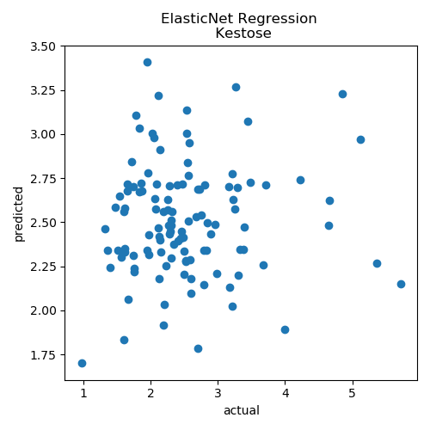
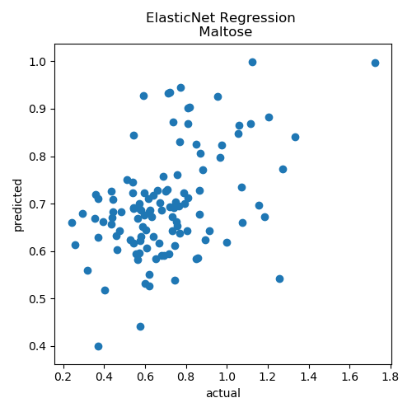
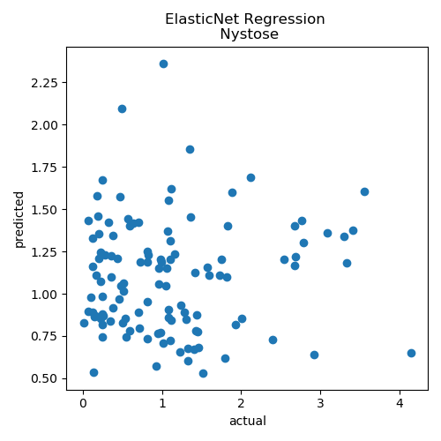
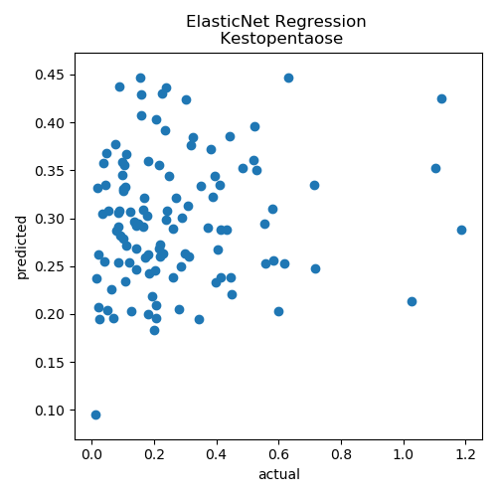
Elastic Net

Slide 24
Lasso
Sugar Contents | Mean absolute error | R^2 error | Mean square error
Glucose | 0.220978 | -0.01924 | 0.080412
Fructose | 0.269796 | -0.01317 | 0.126867
Sucrose | 1.882335 | 0.014208 | 5.482845
Raffinose | 1.104471 | 0.026226 | 1.918576
Kestose | 0.652554 | 0.025089 | 0.73997
Maltose | 0.187364 | 0.119368 | 0.070103
Nystose | 0.678549 | 0.017393 | 0.732928
Kestopentaose | 0.183541 | -0.00063 | 0.058472
Total_Fructan | 3.137438 | -0.01234 | 17.19574

Slide 25
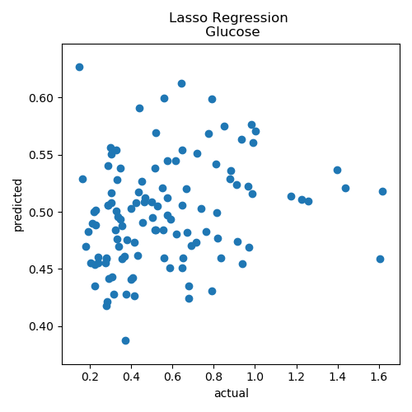
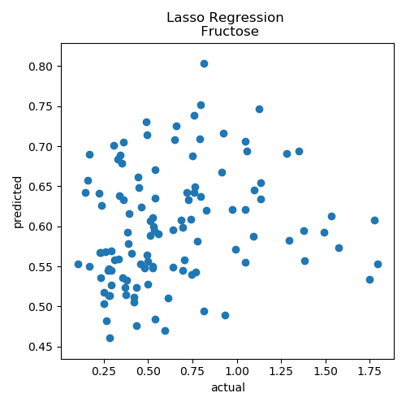
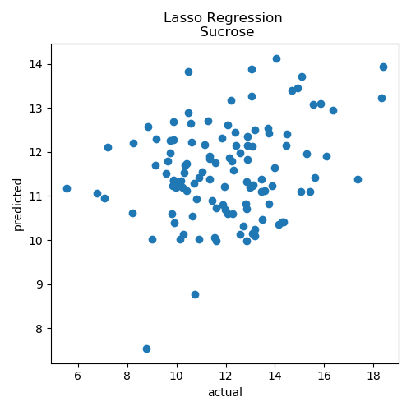
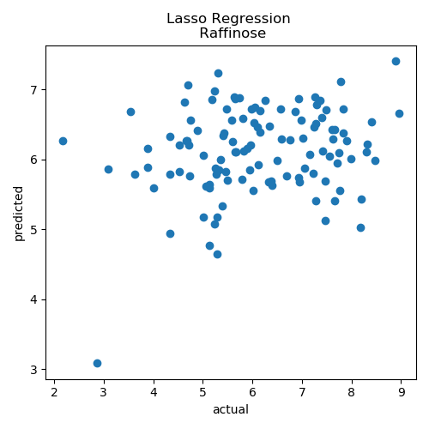
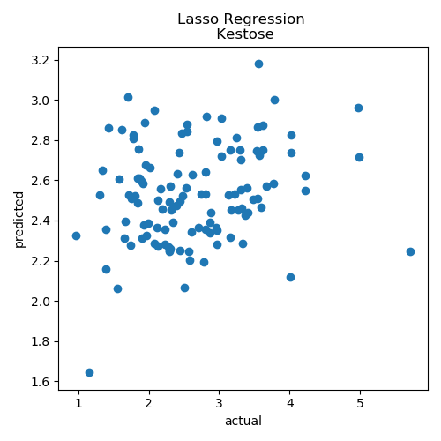
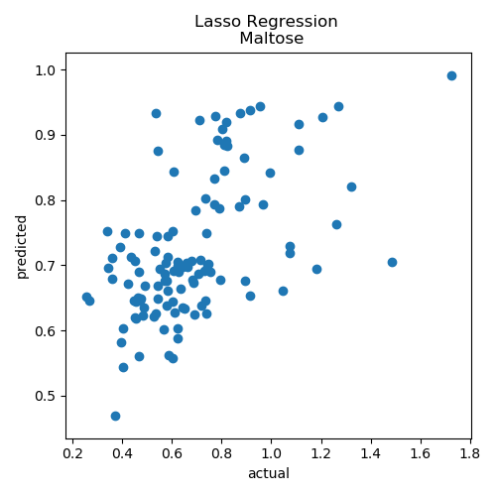


Lasso

Slide 26
R^2 error

Slide 27
Mean absolute error

Slide 28
Mean square error

Slide 29
Dataset against Sugar values
Correlation?

Slide 30




Genotype against dataset
Normally we have three images for each Variety ID
Correlation?
Noise?

Slide 31


Correlation of Dataset and sugar contents individually

Slide 32

Sugar Contents
Mean value of each channel for all the images build our dataset

Slide 33
Removing noisy images
Taking Sucrose in to consideration
Relative Error > 0.4
List of 28 images having relative error larger than 0.4
38371 | 38571 | 38629 | 38805
38390 | 38583 | 38699 | 38806
38405 | 38588 | 38727 | 38824
38473 | 38589 | 38728 | 38828
38475 | 38608 | 38750 | 38858
38530 | 38622 | 38791 | 38861
38568 | 38627 | 38793 | 38865

Slide 34
Removing noisy images

Slide 35
All algorithms tried
Ridge Regression
SVR
Lasso
Elastic Net
Random Forest Regression
Deep Neural Networks
PLS Regression
Stepwise OLS regression

Slide 36
Elastic net

Slide 37
THANK YOU!

